Slide 1
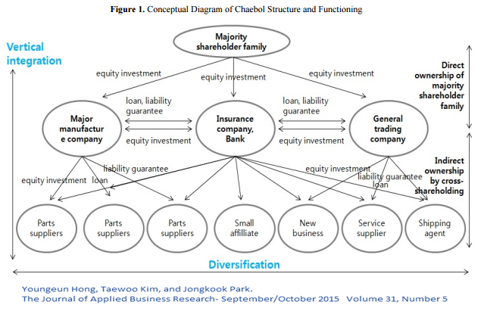

$$ROA_{t−k}$$

Slide 2
Automotive
Construction and Heavy Machinery
Transportation and Warehousing
Electrical and Machinery
Central Bank
Trading and Commerce
Foods
Insurance Company
Real Estate Company
Finance and Insurance
Fiber and Textile
Iron/ Steel

Slide 3




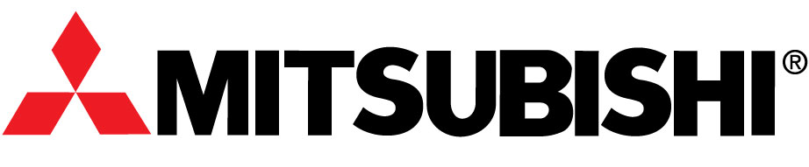
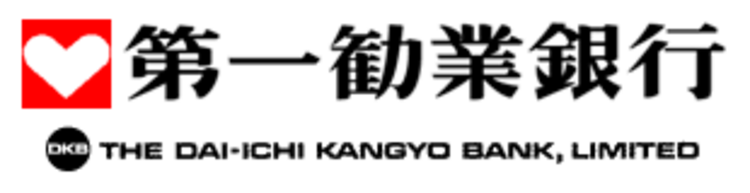



Keiretsu Leaders
Big – 6
Zaibatsu

Slide 4
Meiji Restoration
“Japanese Miracle”
Economy showed recovery
Open policy & introduced technology
High economic growth; export-oriented economy
Modern Japan
1868
1960 – 1980
2005
1945 - 1952
1990
Economic History
Occupied Period after WW II
High Growth Turned Slow
Occupation force brought new technologies and research

Slide 5
Vertical Integration
Major Shareholding Family
Direct ownership of Major Shareholding Family
Equity holding
Equity holding
Equity
holding
Loan, liability, guarantee
Loan, liability, guarantee
Major
Manufacturing Company
Insurance Company/ Bank
Trading Company
Equity holding
Equity holding
Indirect ownership by cross-holding
Equity holding
Liability Guarantee
Equity holding
Loan
Loan
Liability Guarantee
Parts Supplier
Parts Supplier
Parts Supplier
Small Affiliate
New Venture
Service Supplier
Shipping Agent
Credit Issues
Equity Cross-holding Web
Diversification

Slide 6


.4
Sacho-kai membership
to Big – 6 Group
50% Trade Tie
to Big – 6 Group
.3
$$ROA_{t}$$
.2
0% Trade Tie
to Big – 6 Group
.1
$$ROA_{t−k}$$
0
-.2
-.1
0
.1
.2
.3
.4

